Slide 1
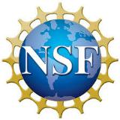
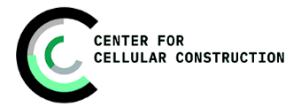
Digital Holographic Reconstruction
Tom Zimmerman
IBM Research-Almaden
Center for Cellular Construction
5.20.23
This material is based upon work supported by the NSF under Grant No. DBI-1548297.
Disclaimer: Any opinions, findings and conclusions or recommendations expressed in this material are those of the authors and do not necessarily reflect the views of the National Science Foundation.

Slide 2
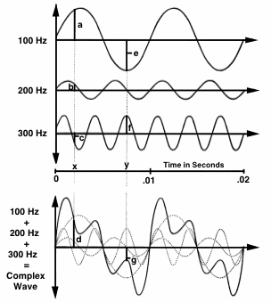
Fourier Analysis & Synthesis
Any time-varying (complex) sound can be analyzed to find its frequency components.
Any complex wave can be constructed by adding together sine waves of appropriate frequency, amplitude, and phase.
https://hearinghealthmatters.org

Slide 3
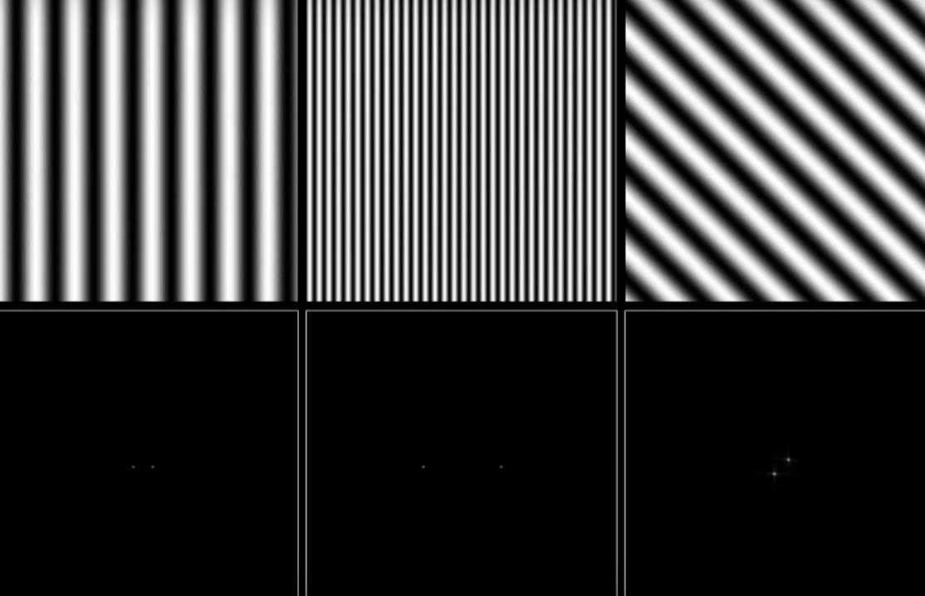
https://youtu.be/gwaYwRwY6PU

Slide 4
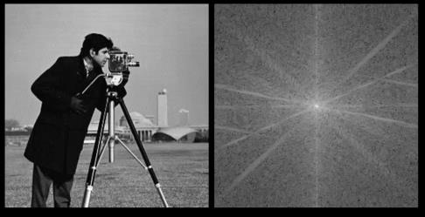

Image of “cameraman” Copyright MIT

Slide 5
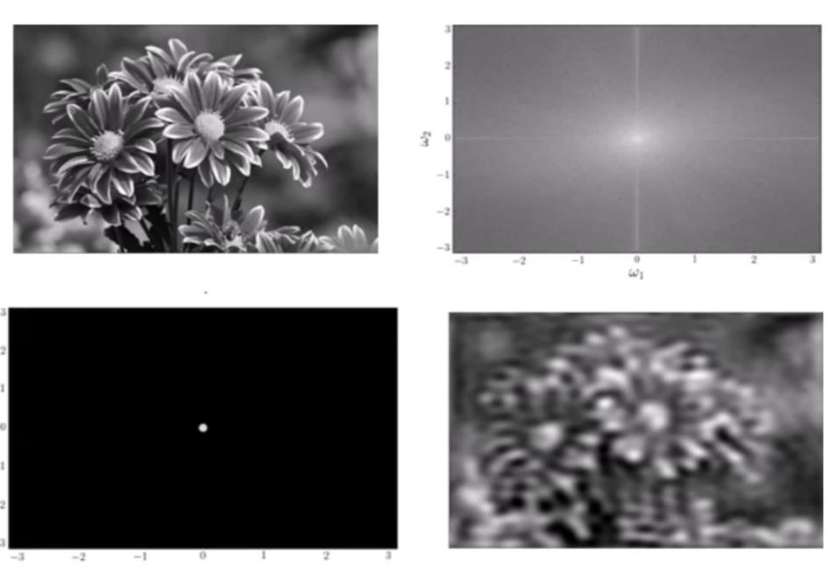
Low Pass Filter
https://youtu.be/oACegp4iGi0

Slide 6
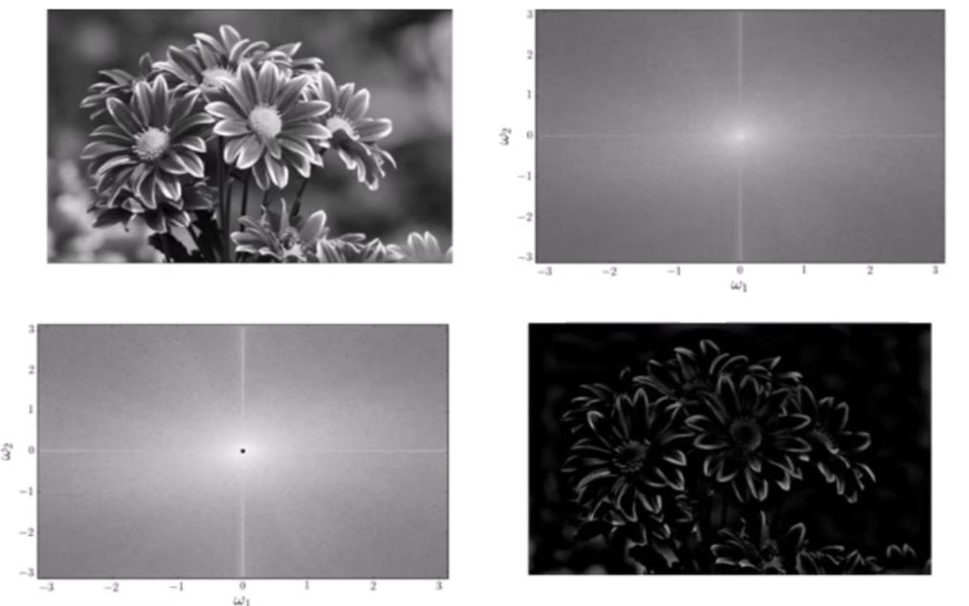
High Pass Filter
https://youtu.be/oACegp4iGi0

Slide 7
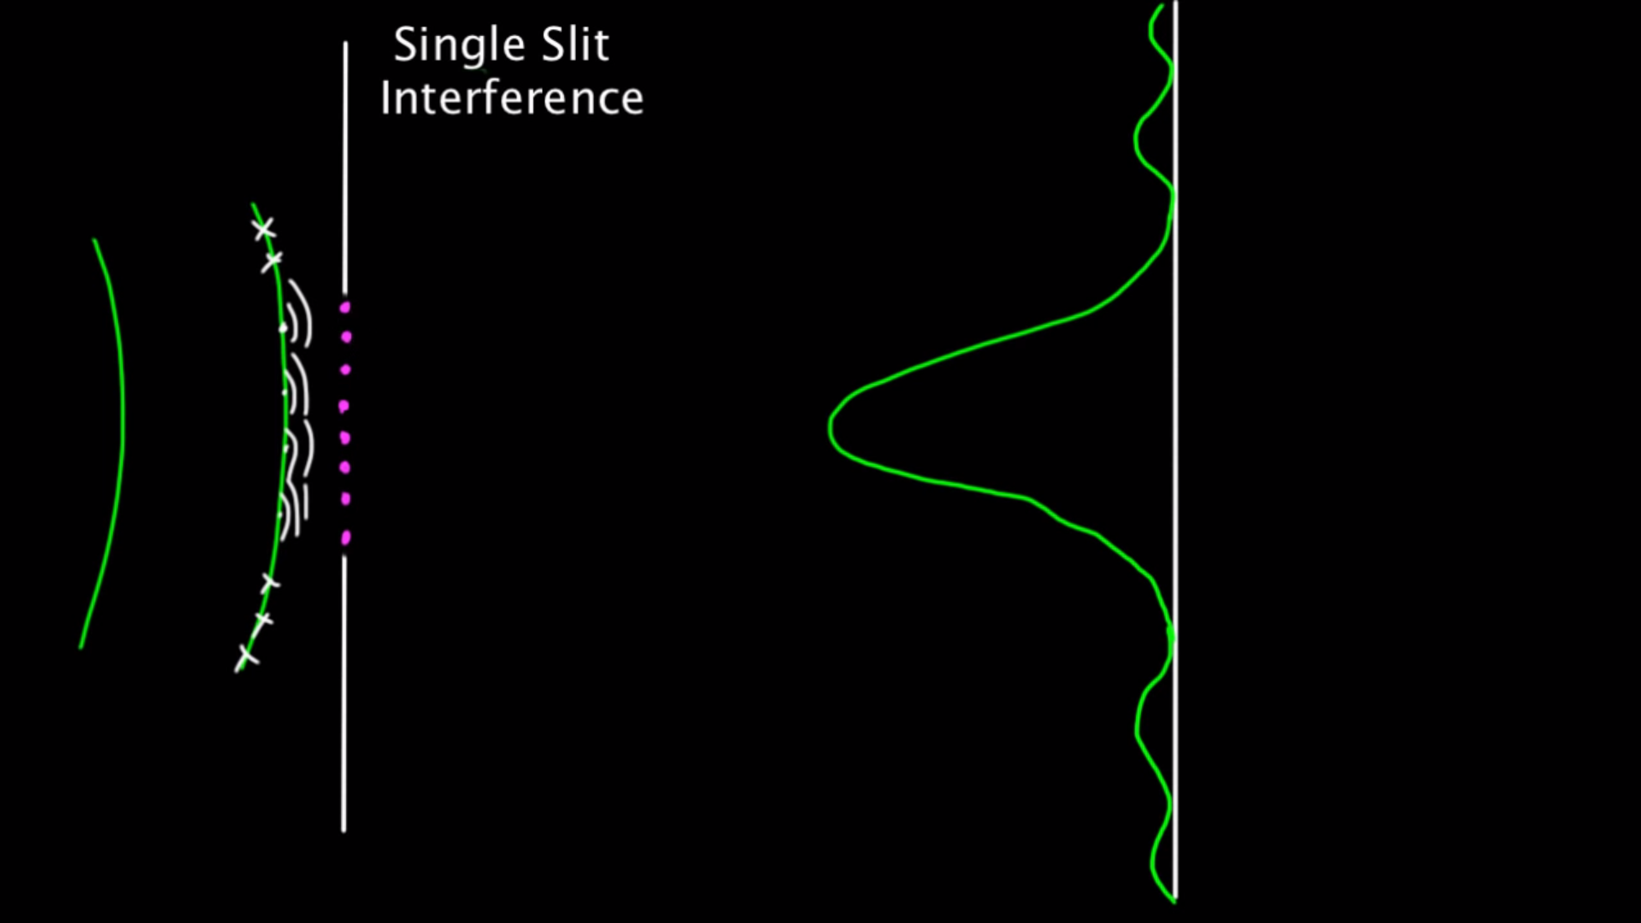
Huygens Principle (1678)
3W/D
2W/D
W/D
W
D

Slide 8
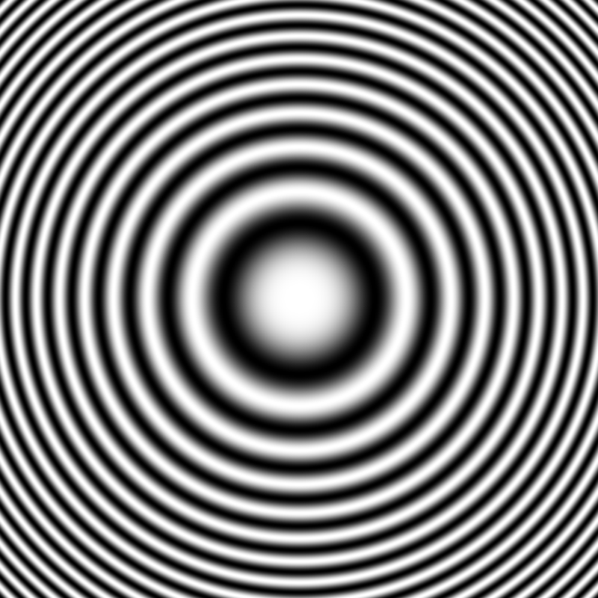
Reconstruction with Laser
Laser
Reconstructed
Subject
Photographic Film of Interference Pattern
(Fresnel Zone Plate for point source)

Slide 9
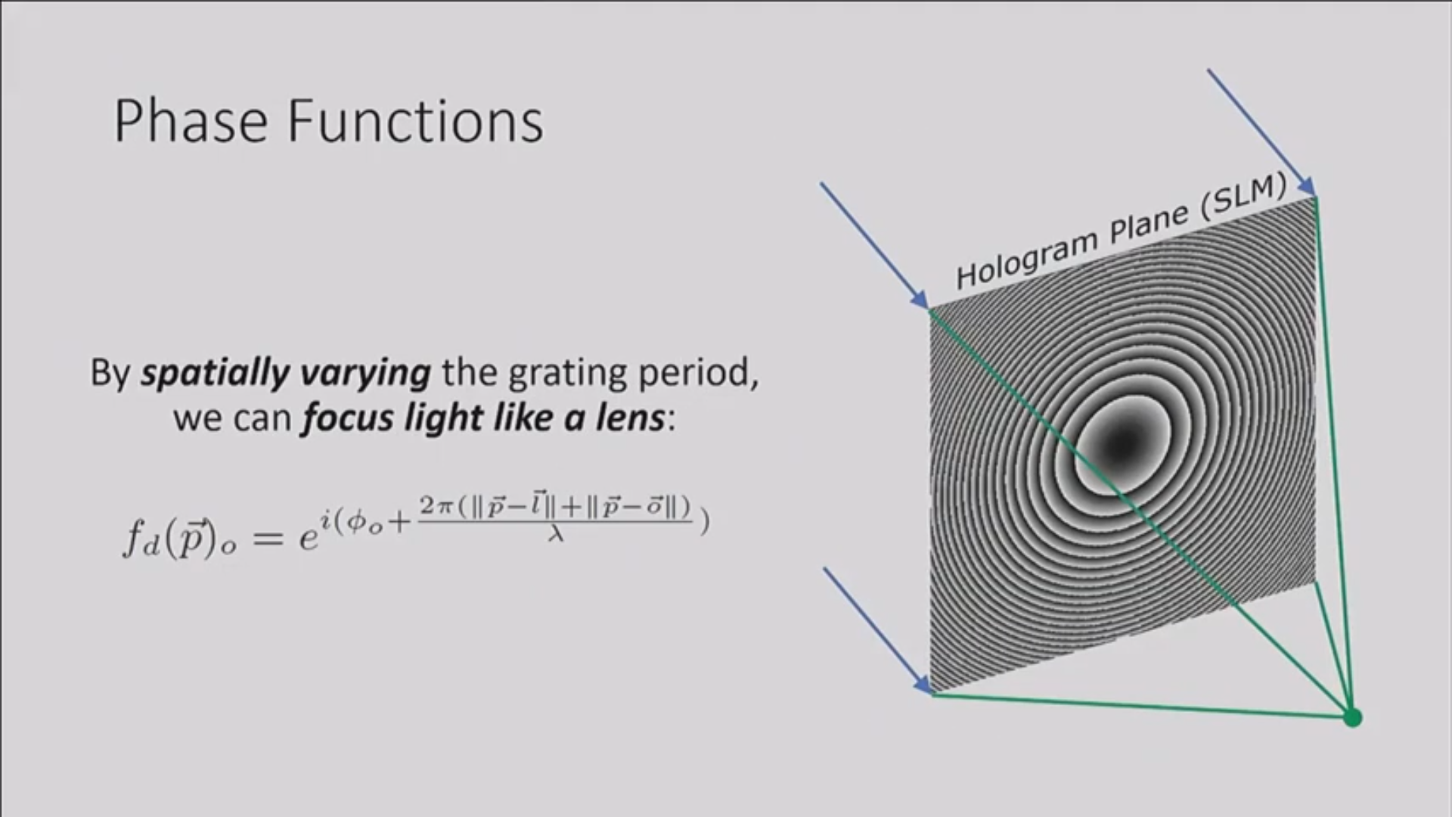
https://youtu.be/oq9UsYHyUvo

Slide 10
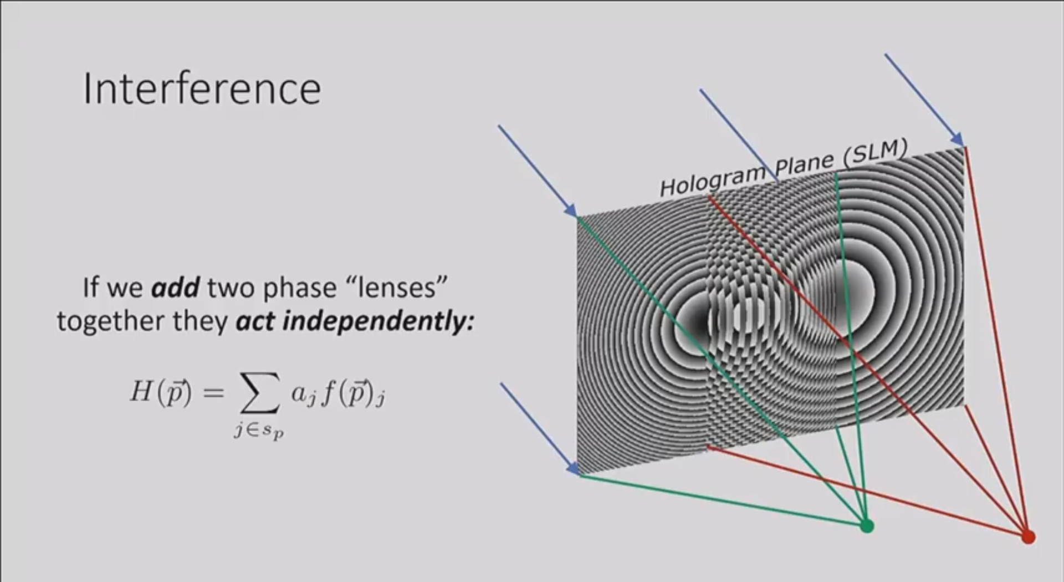
https://youtu.be/oq9UsYHyUvo

Slide 11
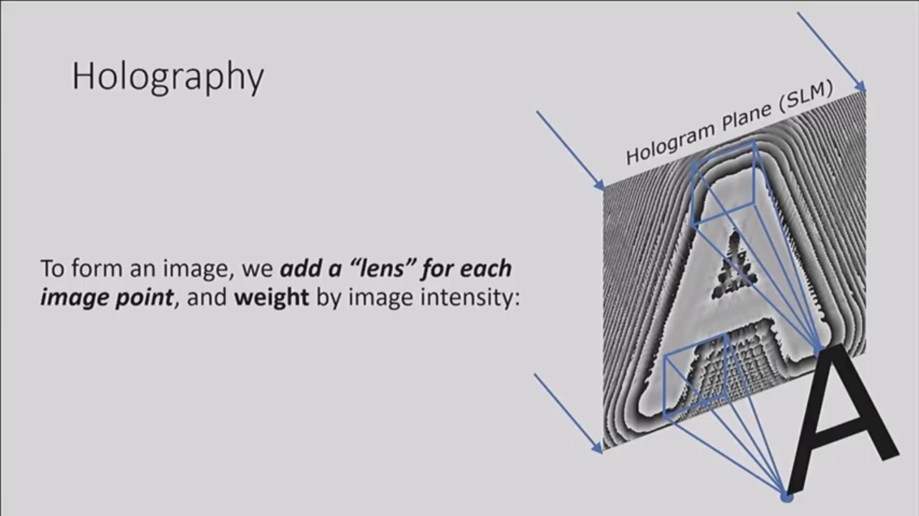
https://youtu.be/oq9UsYHyUvo

Slide 12
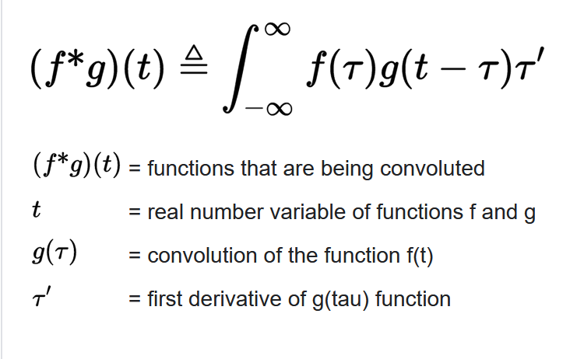
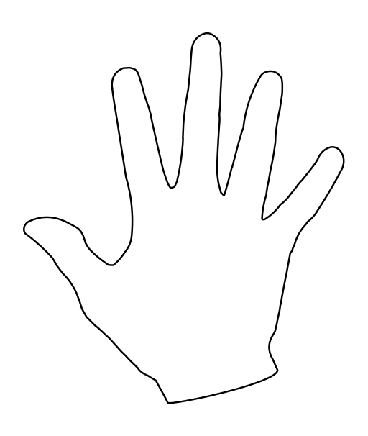
Correlation is measurement of the similarity between two signals.
Convolution is measurement of effect of one signal on the other signal.
Correlation Example
0 .25 .95 1.0
https://www.mathworks.com/matlabcentral/answers/264746-difference-between-convolution-and-correlation
https://upload.wikimedia.org/wikipedia/commons/thumb/f/fa/Hand.svg/512px-Hand.svg.png

